Slide 1
Computer Fundamentals
Before we start DBT module.

Slide 2
First Generation of Computers
First Generation: The period of first generation: 1946-1959.
Second Generation: The period of second generation: 1959-1965.
Third Generation: The period of third generation: 1965-1971.
Fourth Generation: The period of fourth generation: 1971-1980.
Fifth Generation: The period of fifth generation: 1980-onwards.

Slide 3
First Generation of Computers
The period of first generation was from 1946-1959.
The computers of first generation used vacuum tubes as the basic components for memory.
In this generation, mainly batch processing operating system was used. Punch cards, paper tape, and magnetic tape was used as input and output devices.
The computers in this generation used machine code (Machine language is a low-level language made up of binary numbers or bits that a computer can understand.) as the programming language.
The main features of the first generation are −
Vacuum tube technology
Unreliable
Supported machine language only
Very costly
Generated a lot of heat
Slow input and output devices
Huge size
Need of AC
Non-portable
Consumed a lot of electricity

Slide 4
Second Generation of Computers
The period of second generation was from 1959-1965.
In this generation, transistors were used that were cheaper, consumed less power and faster than the first generation machines made of vacuum tubes.
In this generation, magnetic cores were used as the primary memory and magnetic tape and magnetic disks as secondary storage devices.
In this generation, assembly language and high-level programming languages like FORTRAN, COBOL were used. The computers used batch processing and multiprogramming operating system.
The main features of the second generation are −
Use of transistors
Reliable in comparison to first generation computers
Smaller size as compared to first generation
Generated less heat as compared to first generation
Consumed less electricity as compared to first generation
Faster than first generation
Still very costly
AC required
Supported machine and assembly languages

Slide 5
Third Generation of Computers
The period of third generation was from 1965-1971.
The computers of third generation used Integrated Circuits (ICs) in place of transistors. A single IC has many transistors, resistors, and capacitors along with the associated circuitry.
The IC was invented by Jack Kilby. This development made computers smaller in size, reliable, and efficient.
In this generation remote processing, time-sharing, multiprogramming operating system were used. High-level languages (FORTRAN-II TO IV, COBOL, PASCAL PL/1, BASIC, ALGOL-68 etc.) were used during this generation.
The main features of the third generation are −
IC used
More reliable in comparison to previous two generations
Smaller size
Generated less heat
Faster
Lesser maintenance
Costly
AC required
Consumed lesser electricity
Supported high-level language

Slide 6
Fourth Generation of Computers
The period of fourth generation was from 1971-1980.
Computers of fourth generation used Very Large Scale Integrated (VLSI) circuits. VLSI circuits having about 5000 transistors and other circuit elements with their associated circuits on a single chip made it possible to have microcomputers of fourth generation.
Fourth generation computers became more powerful, compact, reliable, and affordable. As a result, it gave rise to Personal Computer (PC) revolution.
In this generation, time sharing, real time networks, distributed operating system were used.
All the high-level languages like C, C++, DBASE etc., were used in this generation.
The main features of the fourth generation are −
VLSI technology used
Very cheap
Portable and reliable
Use of PCs
Very small size
Pipeline processing
No AC required
Concept of internet was introduced
Great developments in the fields of networks
Computers became easily available

Slide 7
Fifth Generation of Computers
The period of fifth generation is 1980-till date.
In the fifth generation, VLSI technology became ULSI (Ultra Large Scale Integration) technology, resulting in the production of microprocessor chips having ten million electronic components.
This generation is based on parallel processing hardware and AI (Artificial Intelligence) software.
All the high-level languages like C and C++, Java, .Net etc., are used in this generation.
The main features of the fifth generation are −
ULSI technology
Development of true artificial intelligence
Development of Natural language processing
Advancement in Parallel Processing
Advancement in Superconductor technology
More user-friendly interfaces with multimedia features
Availability of very powerful and compact computers at cheaper rates

Slide 8
Types of Computers
S.No. | Type | Specifications
1 | Personal Computer | It is a single user computer system having moderately powerful microprocessor
2 | Workstation | It is also a single user computer system, similar to personal computer however has a more powerful microprocessor.
3 | Mini Computer | It is a multi-user computer system, capable of supporting hundreds of users simultaneously.
4 | Main Frame | It is a multi-user computer system, capable of supporting hundreds of users simultaneously. Software technology is different from minicomputer.
5 | Supercomputer | It is an extremely fast computer, which can execute hundreds of millions of instructions per second.

Slide 9
Low level language
A Low-Level Language is also a category of computer programming language in which the computer codes are written in the binary language or machine codes. Because of this, low-level language is sometimes also known as machine language. The low-level language is less friendly for human.
Here is a list of some important characteristics of high-level languages
It can be understood easily by the machine.
It is considered as a machine-friendly language.
It is difficult to understand.
It is difficult to debug.
Its maintenance is also complex.
It is not portable.
It depends on the machine; hence it can't be run on different platforms.
It requires an assembler that would translate instructions.
It is not used widely in today's times.

Slide 10
High level language
A High-Level Language is a computer programming language that uses English like statements to write the computer instructions. High-level languages are most widely programming languages because they are easy to understand to human being.
Here is a list of some important characteristics of high-level languages
It can be easily interpreted as well as compiled in comparison to low-level language.
It can be considered as a programmer-friendly language.
It is easy to understand.
It is easy to debug.
It is simple in terms of maintenance.
It requires a compiler/interpreter to be translated into machine code.
It can be run on different platforms.
It can be ported from one location to another.
It is less memory efficient, i.e., it consumes more memory in comparison to low-level languages.
Examples of high-level languages include C, C++, Java, and Python.
It is widely used.

Slide 11
High level vs Low level language
1. It is programmer friendly language. It is a machine friendly language.
2. High level language is less memory efficient. Low level language is high memory efficient.
3. It is easy to understand. It is tough to understand.
4. Debugging is easy. Debugging is complex comparatively.
5. It is simple to maintain. It is complex to maintain comparatively.
6. It is portable. It is non-portable.
7. It can run on any platform. It is machine-dependent.
8. It needs compiler or interpreter for translation. It needs assembler for translation.
9. It is used widely for programming. It is not commonly used now-a-days in programming.

Slide 12
Evolution of Programming Languages
1883: In the early days, Charles Babbage had made the device, but he was confused about how to give instructions to the machine, and then Ada Lovelace wrote the instructions for the analytical engine.
The device was made by Charles Babbage and the code was written by Ada Lovelace for computing Bernoulli’s number.
1949 Assembly Language: It is a type of low-level language. It mainly consists of instructions that only machines could understand. Assembly language is used in real-time programs such as simulation flight navigation systems and medical equipment.
1952 Autocode: Developed by Alick Glennie. The first compiled computer programming language. COBOL and FORTRAN are the languages referred to as Autocode.
1957 FORTRAN: Developers are John Backus and IBM. It was designed for numeric computation and scientific computing. Software for NASA probes voyager-1 (space probe) and voyager-2 (space probe) was originally written in FORTRAN 5.
1958 ALGOL: ALGOL stands for ALGOrithmic Language. The initial phase of the most popular programming languages of C, C++, and JAVA. It was also the first language implementing the nested function and has a simple syntax than FORTRAN. The first programming language to have a code block like “begin” that indicates that your program has started and “end” means you have ended your code.

Slide 13
Evolution of Programming Languages
1959 COBOL: It stands for Common Business-Oriented Language. In 1997, 80% of the world’s business ran on Cobol.
1964 BASIC: It stands for beginners All-purpose symbolic instruction code. In 1991 Microsoft released Visual Basic, an updated version of Basic the first microcomputer version of Basic was co-written by Bill Gates, Paul Allen, and Monte Davidoff for their newly-formed company, Microsoft.
1972 C: It is a general-purpose, procedural programming language and the most popular programming language till now. All the code that was previously written in assembly language gets replaced by the C language like operating system, kernel, and many other applications. It can be used in implementing an operating system, embedded system, and also on the website using the Common Gateway Interface (CGI). C is the mother of almost all higher-level programming languages like C#, D, Go, Java, JavaScript, Limbo, LPC, Perl, PHP, Python, and Unix’s C shell.

Slide 14
Evolution of Programming Languages
1972 SQL: SQL was developed at IBM by Donald D. Chamberlin and Raymond F. Boyce. The earlier name was SEQUEL (Structured English Query Language).
1978 MATLAB: It stands for MATrix LABoratory. It is used for matrix manipulation, implementation of an algorithm, and creation of a user interface.
1983 Objective-C, C++: C++ is the fastest high-level programming language. Earlier, Apple Inc uses Objective-C to make applications.
1990 Haskell: It is a purely functional programming language.
1991 Python: The language is very easy to understand. Famous language among data scientists and analysts.
1995 JAVA, PHP, JavaScript: JAVA is everywhere. JAVA is the platform-independent language. PHP is a scripting language mainly used in web programming for connecting databases. JavaScript enables interactive web pages. JS is the most popular programming language. JS is famous for building a web application. It makes our page interactive.

Slide 15
Number Systems
A number is a mathematical value used for counting or measuring or labelling objects.
Numbers are used to performing arithmetic calculations.

Slide 16
Types of Number Systems
Types of Number Systems
Decimal number system (Base- 10) => 0, 1, 2, 3, 4, 5, 6, 7, 8, 9
Binary number system (Base- 2) => 0, 1
Octal number system (Base-8) => 0, 1, 2, 3, 4, 5, 6, 7
Hexadecimal number system (Base- 16) => 0, 1, 2, 3, 4, 5, 6, 7, 8, 9, 10, 11, 12, 13, 14, 15
A B C D E F

Slide 17
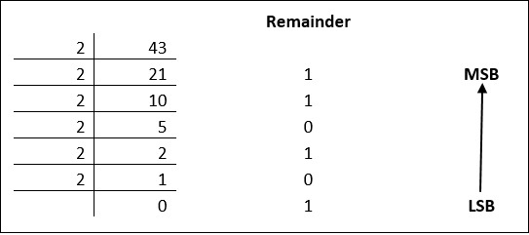
Number Systems
Decimal to Binary => (43) ₁₀ = (?)₂
Decimal numbers can be converted to binary by repeated division of the number by 2 while recording the remainder.
most-significant digit (MSD)
least-significant digit (LSD)
Binary to Decimal Conversion
1 × 2³ + 1 × 2² + 0 × 2¹ + 1 × 2⁰
= 8 + 4 + 0 + 1
= 13

Slide 18
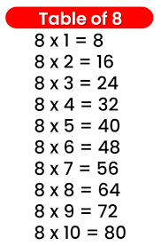
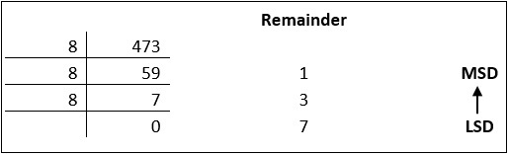
Number Systems
Decimal to Octal => (473) ₁₀ = (?)₈
Decimal numbers can be converted to octal by repeated division of the number by 8 while recording the remainder.
Octal to Decimal Conversion
7 × 8² + 3× 8¹ + 1 × 8⁰
= 448 + 24 + 1
= 731

Slide 19
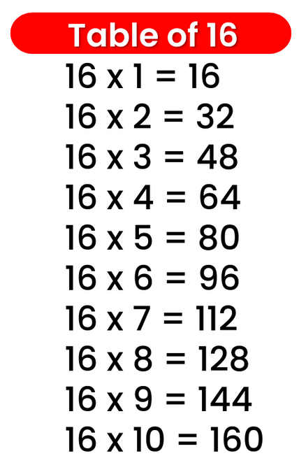
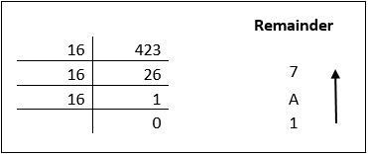
Number Systems
Decimal to Hexadecimal => (423) ₁₀ = (?)₁₆
Decimal numbers can be converted to octal by repeated division of the number by 16 while recording the remainder.

Slide 20
Algorithm and Flowcharts
Algorithms: An algorithm is a step-by-step method to solve problems. It includes a series of rules or instructions in which the program will be executed.
Flowchart: A flowchart is a pictorial representation of an algorithm.

Slide 21
Big Data
A day without new knowledge is a lost day.
Before we start DBT module.

Slide 22
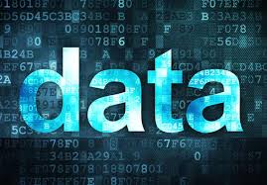
What is data?

Slide 23
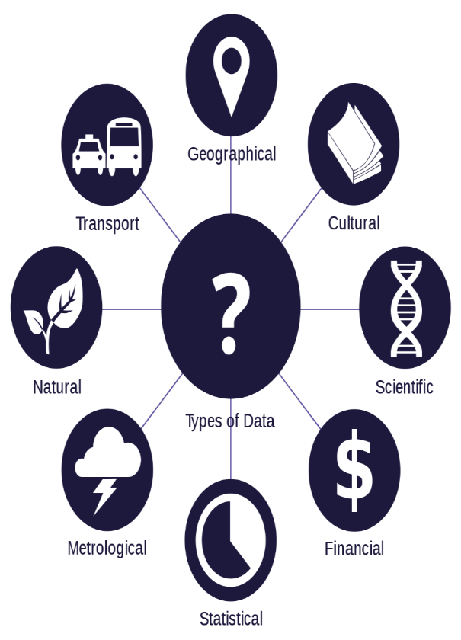
what is data
Data is any facts that can be stored and that can be processed by a computer.
Data can be in the form of Text or Multimedia
e.g.
number, characters, or symbol
images, audio, video, or signal

Slide 24
What is big data?

Slide 25
what is big data
Big Data is a collection of data that is huge in volume, yet growing exponentially with time. It is a data with so large size and complexity that none of traditional data management tools can store it or process it efficiently.

Slide 26
Characteristics of Big Data

Slide 27
Characteristics of Big Data
It is used by many multinational companies to process the data and business of many organizations. The data flow would exceed 150 exabytes per day before replication.
There are five v's of Big Data that explains the characteristics.
5 V's of Big Data
Volume
Velocity
Variety
Veracity
Value

Slide 28
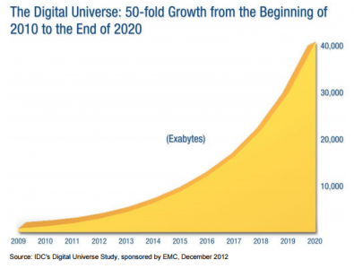
Volume
The name Big Data itself is related to an enormous size of data. Big data technologies can handle large amounts of data.
Big Data is a vast 'volumes' of data generated from many sources daily, such as business processes, machines, social media platforms, networks, human interactions, and many more.
Facebook can generate approximately a billion messages,
Billion of times, the "Like" button is recorded,
and millions of new posts are uploaded each day.
Big data velocity deals with the speed at the data flows from sources like application logs, business processes, networks, and social media sites, sensors, mobile devices, etc.

Slide 29
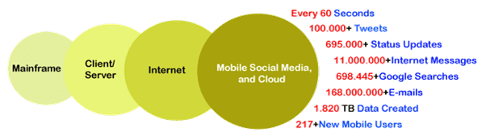
Velocity
Velocity describes how rapidly the data is generated and how quickly it moves. This data flow comes from sources such as mobile phones, social media, networks, servers, etc. Velocity covers the data's speed, and it also describes how the information continuously flows.

Slide 30
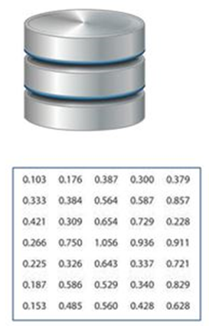
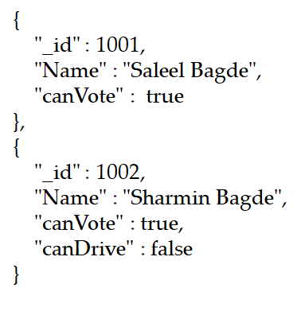

Variety
Structured
Semi-Structured
Unstructured

Slide 31
Variety
Structured
The data that can be stored and processed in a fixed format is called as Structured Data. Data stored in a relational database management system (RDBMS) is one example of ‘structured’ data. It is easy to process structured data as it has a fixed schema. Structured Query Language (SQL) is often used to manage such kind of Data.
Semi-Structured
Semi-Structured Data is a type of data which does not have a formal structure of a data model, i.e. a table definition in a relational DBMS, XML files or JSON documents are examples of semi-structured data.
Unstructured
The data which have unknown form and cannot be stored in RDBMS and cannot be analyzed unless it is transformed into a structured format is called as unstructured data. Text Files and multimedia contents like images, audios, videos are example of unstructured data.
Quasi-structured Data: The data format contains textual data with inconsistent data formats that are formatted with effort and time with some tools.

Slide 32
Veracity
It refers to the assurance of quality/integrity/credibility/accuracy of the data. Since the data is collected from multiple sources, we need to check the data for accuracy before using it for business insights.
Value
Value is an essential characteristic of big data. It is not the data that we process or store. It is valuable and reliable data that we store, process, and also analyze.
Value refers to how useful the data is in decision making.

Slide 33
Jobs in Big Data

Slide 34
List of Job Roles in Data Science / Big Data
MIS Reporting Executive: Business managers rely on Management Information System reports to automatically track progress, make decisions, and identify problems.
Business Analyst: Although many of their job tasks are similar to that of data analysts, business analysts are experts in the domain they work in. They try to narrow the gap between business and IT.
Data Analyst: A Data Analyst's responsibilities include the deep analysis of data and then determining the best way to represent it visually to managers and stakeholders. They also ensure quality assurance and process documentation and define Key Performance Indicators
Statistician: Statisticians collect, organize, present, analyze, and interpret data to reach valid conclusions and make correct decisions. They are key players in ensuring the success of companies involved in market research, transportation, product development, finance, forensics, sport, quality control, environment, education, and also in governmental agencies.
Data Scientist: A Data Scientist is a professional who collects large amounts of data using analytical, statistical, and programmable skills. It is their responsibility to use data to develop solutions tailored to meet the organization's unique needs.

Slide 35
List of Job Roles in Data Science / Big Data
Data Engineer/Data Architect: “Data engineers are the designers, builders and managers of the information or “big data” infrastructure.” Data engineers ensure that an organization’s big data ecosystem is running without glitches for data scientists to carry out the analysis.
Machine Learning Engineer: A Machine Learning Engineer is responsible for designing and developing machine learning systems, implementing appropriate ML algorithms, and conducting experiments. They possess strong programming skills, knowledge of data science, and expertise in statistics.
Big Data Engineer: The big data engineer's role is to Design, construct and maintain large-scale data processing systems.

Slide 36
Big Data Frameworks

Slide 37
Big Data Frameworks and programming language
Apache Hadoop
Spark
Apache Hive
Apache Storm
Apache Flink
Apache Heron
Apache Kafka
Apache Cassandra, etc.
Python
Java
R
C++
Scala
Go
MATLAB
JavaScript
Julia

Slide 38
Big Data Programming Paradigms

Slide 39
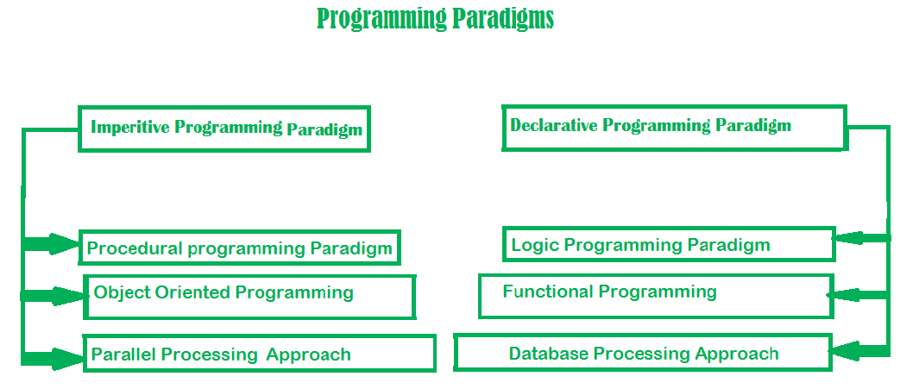

Slide 40
Imperative programming paradigm
Imperative programming paradigm: It is one of the oldest programming paradigm. It features close relation to machine architecture. It is based on Von Neumann architecture. It works by changing the program state through assignment statements. It performs step by step task by changing state. The paradigm consist of several statements and after execution of all the result is stored.
Advantages:
Very simple to implement
It contains loops, variables etc.
Disadvantage:
Complex problem cannot be solved
Less efficient and less productive
Parallel programming is not possible
int marks[5] = { 12, 32, 45, 13, 19 }
int sum = 0;
float average = 0.0;
for (int i = 0; i < 5; i++) {
sum = sum + marks[i];
}
average = sum / 5;
Imperative programming is divided into three broad categories: Procedural, OOP and parallel processing.

Slide 41
procedural programming paradigm
Procedural programming revolves around a sequence of instructions given to the computer. These sequences of instructions are known as procedures.
Since the instructions are carried out in well-defined sequences, we say that procedural programming takes a top-down approach.
In procedural programming, we divide our instructions into smaller blocks of well-defined code. These code blocks are known as functions, where each function performs a specific task.

Slide 42
object oriented programming paradigm

Slide 43
parallel processing programming paradigm

Slide 44
Introduction to Data Science and Skillset required for working with Big Data

Slide 45
Data Science and Skillset required for working with Big Data
Data science is an associative field of scientific methods, processes, algorithms, and systems to extract knowledge from data in various forms, either structured or unstructured, similar to data mining.
Technical skills: Data science requires proficiency in programming languages such as Python or R, data visualization tools like Tableau or Power BI, databases such as SQL, and machine learning algorithms.
Domain expertise: Data scientists should have an understanding of the business domain in which they work. For example, a data scientist in healthcare should have knowledge of medical terminologies and healthcare workflows.
Soft skills: Soft skills like communication, collaboration, and problem-solving are essential for a successful data scientist. Data scientists should be able to communicate complex technical concepts to non-technical stakeholders in a clear and concise manner.

Slide 46
Types of Machine Learning (Supervised, Un-Supervised, Reinforcement)

Slide 47
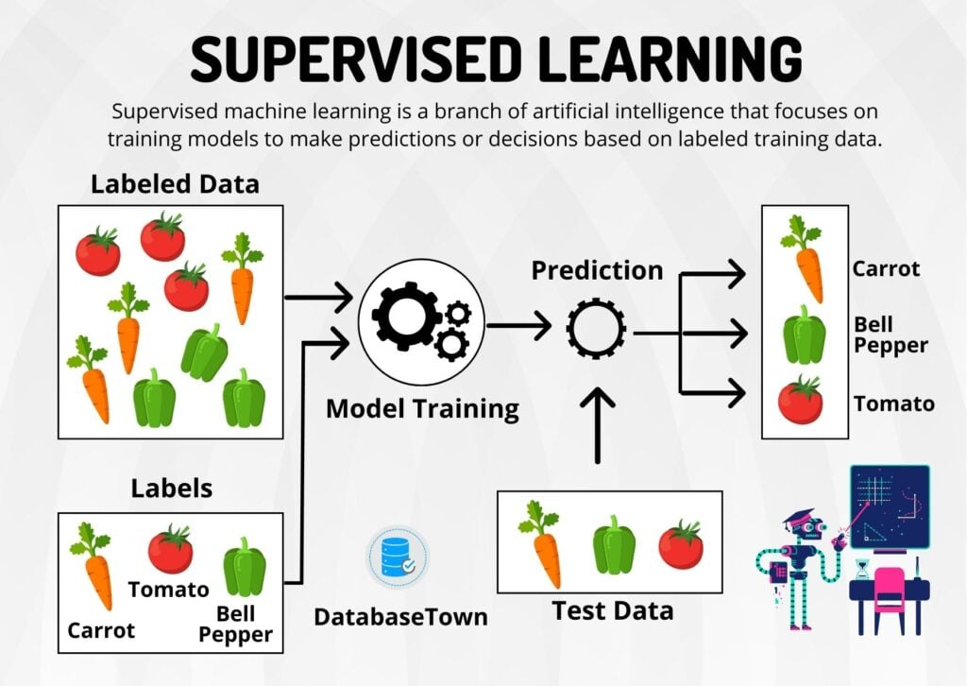
Supervised Learning
Supervised machine learning has two key components: first is input data and second corresponding output labels. The goal is to build a model that can learn from this labeled data to make predictions or classifications on new, unseen data.
The labeled data consists of input features and the corresponding output labels.

Slide 48
Supervised Learning
Medical Diagnosis: Supervised algorithms are also used in the medical field for diagnosis purposes. It is done by using medical images and past labelled data with labels for disease conditions. With such a process, the machine can identify a disease for the new patients.
Fraud Detection - Supervised Learning algorithms are used for identifying fraud transactions, fraud customers, etc. It is done by using historic data to identify the patterns that can lead to possible fraud.
Spam detection - In spam detection & filtering algorithms are used. These algorithms classify an email as spam or not spam. The spam emails are sent to the spam folder.

Slide 49
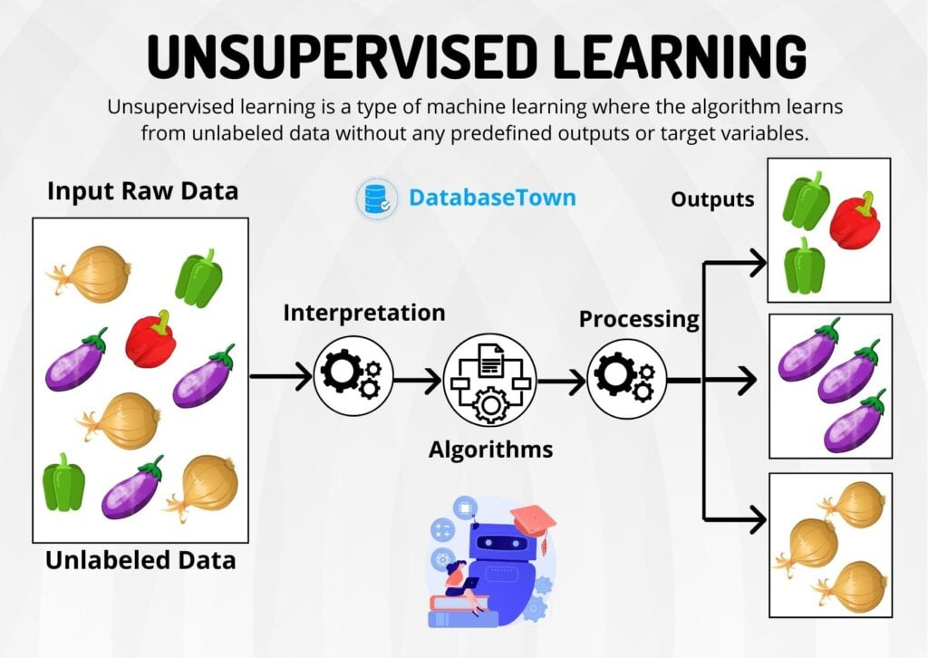
Unsupervised Learning
Unsupervised learning is a type of machine learning where the algorithm learns from unlabeled data without any predefined outputs or target variables. The unsupervised learning finds patterns, similarities, or groupings within the data to get insights and make data-driven decisions.

Slide 50
Reinforcement Learning

